Slide 1


Reasons I like computing language and Maths
DON BOSCO INSTITUTE OF TECHNOLOGY
DEPARTMENT OF INFORMATION SCIENCE AND ENGINEERING

Slide 2
Bachelor Of Engineering In Information Science & Engineering
During the Academic year 2021 -2022
Submitted By,
Pavan Raj B 1DB18IS056
Sumanth Gowda D M 1DB18IS084
Poojith S 1DB18IS058
Under the Guidance of,
Mr. Basavaraj Neelagund
Asst Professor, Department of ISE, DBIT

Slide 3
CONTENTS
MOTIVATION
INTRODUCTION
EXISTING SYSTEM
PROPOSED SYSTEM
ARCHITECTURE / WORK-FLOW
METHODOLOGY
REFERENCES

Slide 4
content
Basic knowledge
Rules/structure
operators
Conditional statements
Looping statements
Arrays

Slide 7
Rules/structure
Either in mathematics or in computer language if u don’t follow the rules u wont get desired result

Slide 8
operators
Arithmetic operators(+,-,*,/,%)
5 x 9 = 5 * 9 ;
Logical operators(<,>,<=,>=)
10 greater than 5=> 10 > 5
Assignment operator(=)
String name = ram;

Slide 9
Conditional Statments

Slide 11
conditional Statements
Statement which are used to decides
If , if else, if else if ,switch
If else condition
String name= ram;
Int age =18;
If (age>18){
Print(“ram is adult”)
else
Print(“ram is not an adult”)

Slide 12

MOTIVATION
People in developing and underdeveloped economies face medical emergencies on a daily basis. In those time identifying patient and gathering their critical information could be lifesaving.
Identifying an uncommunicative and unresponsive patients is difficult task, failing to identify may result in wrong course of treatment or sometimes may lead to a tragic end.
This could be avoided we some how store the critical information and map those information to unique digital identity of the person.
Facial Data is one of the unique identifier, So our system propose that Facial Recognition can play as an alternative to identify the patients in case of Emergency.

Slide 13

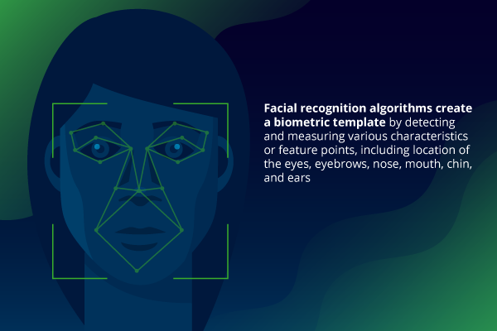
INTRODUCTION
As we all know Computer vision is the part of AI, In which Image processing is major component, This image processing as many Application such as object detection, Face Recognition and so on..
So What Exactly is Facial Recognition, It is method to identify the people using facial data, there are about 80 different feature in face which is unique to all, using these unique feature we will identify the person.
So in our system using these technique we will map the patient information to is unique Facial Id, using which we access the required data at the time of Emergency.

Slide 14
Literature Review
Sl No | Author | title | algorithms
1 | Vinay Kumar Verma, Vanika Kansal & Pankhuri Bhatnagar | Patient Identification Using Facial Recognition | Haar cascade classifier PCA Cosine distance
2 | V. D. Ambeth Kumara, V. D. Ashok Kumarb , S. Malathia , K. Vengatesanc , and M. Ramakrishnan | Facial Recognition System for Suspect Identification Using a Surveillance Camera | Haar cascade classifier PCA
3 | Ninad Mehendale · Mamata Parab | Face recognition-based automatic hospital admission with SMS alerts | Viola-Jones Fusion of PCA and ANN
4 | Aftab Ahmed, Jiandong Gio, Fayaz Ali & Farha Deeba | LBPH Based Improved Face Recognition At Low Resolution | LBPH Algorithm

Slide 15
Disadvantages of Existing System:
EXISTING SYSTEMS
In Early days, The hospitals had to depend on the Basic pen and paper method but thanks to technology we have evolved from paper and pen to electronic data.
Later on, these data were accessed using biometric such as Fingerprint, Iris. Recently hospital are purposed with Facial Recognition to identify them.
Early pen and paper model were tedious to work. Due to accident or emergency we couldn’t access the patients biometrics.
In the previously purposed system it was inefficient due to low lighting and low resolution.
It does not provide patients information privacy.

Slide 16

PROPOSED SYSTEM:
In this system we propose a Alternative to Identify the patients based on facial recognition using LBPH algorithm.
In this paper we enhance the previously existing system by using Local Binary Patter Histogram Algorithm to extract and verify the facial features
ADVANTAGES OF PROPOSED SYSTEM:
Effective even in low resolution and low lighting condition.
Provides patient information privacy using restricting the login only to specified authority.

Slide 17
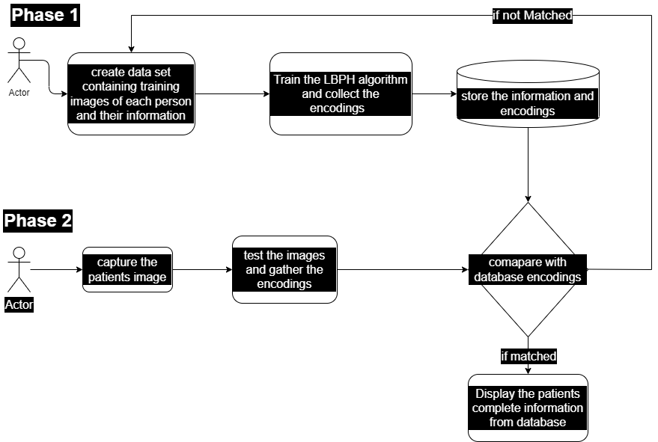
ARCHITECTURE / WORK-FLOW

Slide 18
METHODLOGY
PHASE-ONE
Creation of data set :- which consist of training images of each person and their medical information.
Store these data :- Data collected will be stored in database, if we store the data in local database patient info will be restricted only to one hospital. If we store in cloud based database these data can be accessed by all the hospitals.
PHASE-TWO
Capture the images of patient who is to identify. And generate the encodings
Compare the encodings with the data base and gather the information.
If no records found create the dataset for the patient for future requirement.

Slide 19
FACILITIES REQUIRED FOR PROPOSED WORK
Hardware requirement's
Software requirement's
System : Intel core i3 processor
Hard Disk : 120 GB.
Monitor : 15’’ LED
Input Devices: Keyboard, Mouse
Ram : 4GB
Operating system: Windows – 7/8/10.
Coding Language: PYTHON (OpenCV Library)
Tool : VS CODE
Database: MongoDB

Slide 20
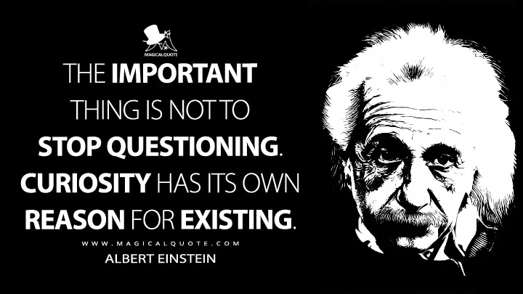
There is no good or bad question, It just depends on the person answering. So try me:)

